Slide 1
Information and Communication Technology
GPS SYSTEM

Slide 2

1. History and Introduction of
GPS
Presented by Fatima Noorulain

Slide 3
GPS SYSTEMS
GPS: Global Positioning System,
It is a satellite-based navigation system.
Enables precise location determination and navigation on Earth.
Network of satellites orbiting the Earth.

Slide 4
The first GPS satellite, Navstar 1, was launched.
President Reagan allowed civilian use of GPS, improving accuracy.
1978
1983
1989
1994
GPS became fully operational with 24 satellites.
GPS achieved full global coverage with 24 satellites.
EVOLUTION OF GPS SYSTEM 1978-1994

Slide 5
Selective Availability was turned off, enhancing civilian accuracy.
Full deployment of Block IIF satellites began, offering improved accuracy and signal reliability.
GPS III satellites became fully operational, providing better accuracy and security.
2000
2005
2010
2016
2020
First Block IIR-M satellite launched, modernizing the GPS constellation.
Initial launch of Block III satellites, featuring enhanced capabilities.
EVOLUTION OF GPS SYSTEM 2000-2020

Slide 6

2. Working Principle / Architecture
Presented by Eashal Yasin

Slide 7




GPS COMPONENTS
The GPS system comprises three key segments:
Space Segment
Control Segment
User Segment

Slide 8
GPS SYSTEM
Space Segment
Control Segment
User Segment
Network of 29 Navstar satellites.
Orbits at approximately 20,000 km above Earth's surface.
Travels at a speed of 14,000 km/hr.
Constantly transmits coded radio signals.
Ground-based control stations monitor GPS satellites.
Ensures satellite functionality and accurate orbits.
GPS receivers determine an object's position on Earth's surface.
Receives radio signals from GPS satellites.
Uses the information to calculate the receiver's position.

Slide 9
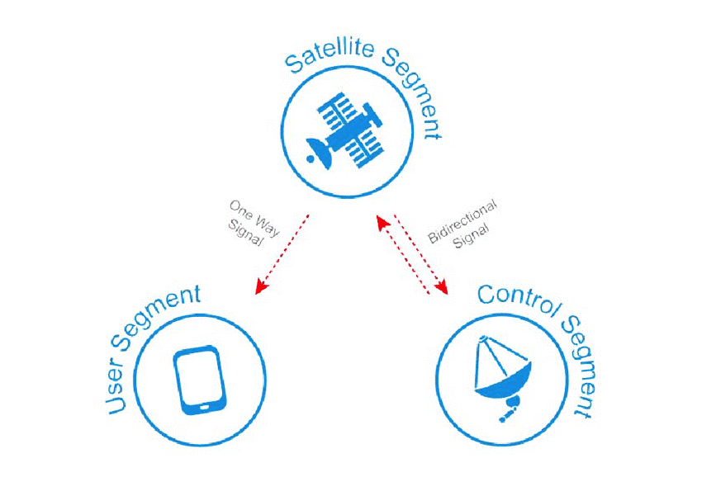
KEY SEGMENTS
Satellites transmit coded radio signals
GPS receivers calculate position using received signals.
Ground-based stations monitor and maintain satellite functionality.

Slide 10
3. Applications
Presented by Zunaira Abdul Aziz

Slide 11
Applications OF GPS
1
02
03
Navigation and Tracking
Car Navigation Systems
Mobile Apps
Handheld GPS Devices
Emergency Services
2
911 calls
search and rescue operations
3
Surveying and Mapping
Land Surveying
Infrastructure Mapping

Slide 12
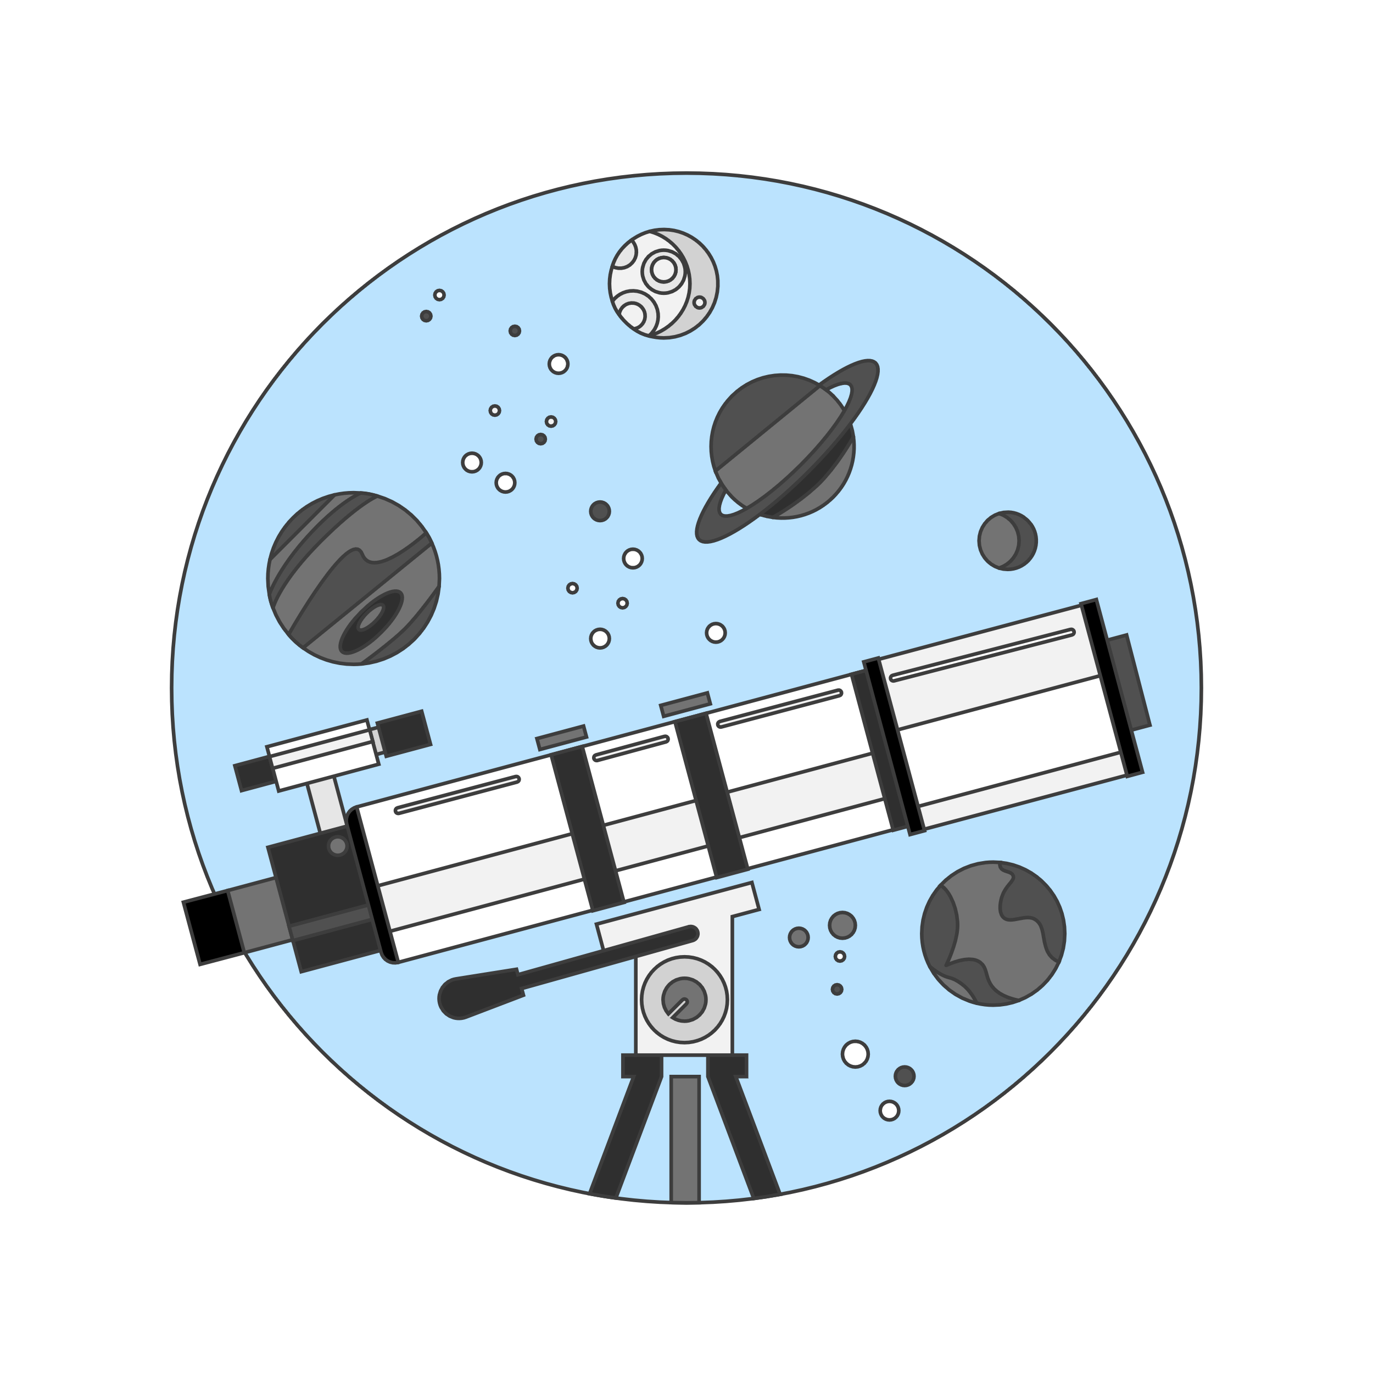
Presented by Fatima Khalid
4. Real-time case studies

Slide 13
STUDY CASE 1
Study Conducted by: GPS Research Institute in collaboration with the Department of Geographical Sciences at the University of Maryland.
Aim of the Study: To analyze the accuracy and reliability of GPS data in various geographical settings.
Achievements of the Study:
The GPS system performed exceptionally well in urban areas with clear line of sight to satellites.
The system experienced reduced accuracy in dense forests and mountainous regions.
Regular updates and maintenance of GPS devices are important to ensure optimal performance.

Slide 14
STUDY CASE 2
Study Conducted by: National Institute of Standards and Technology (NIST).
Aim of Study: To evaluate the accuracy and reliability of GPS systems.
Achievements:
GPS systems can be affected by a variety of factors, including atmospheric conditions, satellite geometry, and receiver design.

Slide 15
STUDY CASE 3
Study Conducted by: European GNSS Agency (GSA).
Aim of Study : To evaluate the performance of GPS systems in different regions of the world.
Achievements of Study:
There were significant differences in accuracy and reliability between different systems and environments.

Slide 16

THANK YOU!

